Slide 1


ENERGY INSTITUTE
Using predictive modelling techniques to study the impact of COVID-19 on domestic energy consumption in GB
Dr Ellen Zapata-Webborn
Paper pre-print: https://osf.io/m5p3b/
_{Wednesday 8}^{th} _{March, 2023}

Slide 2
(SERL) 5-year consortium project led by UCL Energy Institute
www.serl.ac.uk

Slide 3

















Gas data
Electricity data
Daily, half-hourly
All participants with a DCC-enrolled mains gas meter from up to 12 months before consent onwards
Daily, half-hourly
All participants (in theory)
From up to 12 months before consent onwards
SERL
Observatory Data 13,000+
households in GB
Weather data
Location data
ECMWF ERA5 reanalysis data
Hourly, 30km resolution
24 variables
Region, LSOA, IMD quintile
Energy Performance Certificate (EPC)
SERL Survey
40 questions on the dwelling and household
One-off collection at sign up
~50% of participants
Sourced from EPC Register
https://www.mdpi.com/1996-1073/14/21/6934

Slide 4
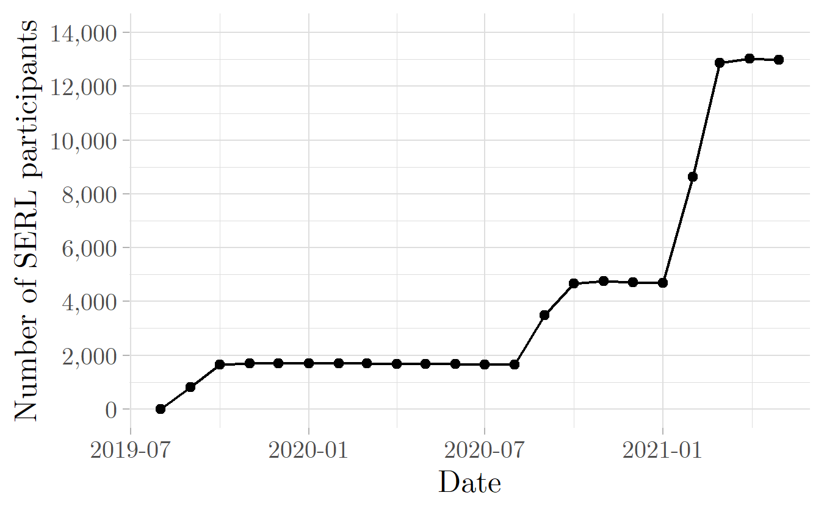
Recruitment since 2019
Total recruited:
13,321
Still ‘active’ in May 2021: 12,992
May 2021: 12,992
8444
wave 3
Households known to have a smart meter sent letters
3169 wave 2
1708 wave 1
https://www.mdpi.com/1996-1073/14/21/6934

Slide 5

Cast your mind back to January 2020…
SERL has been collecting smart meter data from 1700 households dating back ~6-18 months
Planning the 2nd recruitment wave
Research projects planned, things are running ‘fairly’ smoothly
“COVID-19” is barely on the UK radar

Slide 6

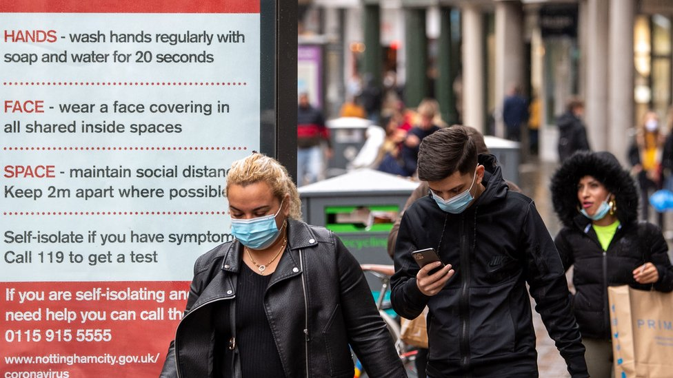

23rd March 2020
First national lockdown in the UK
Notes:
Offices, schools, restaurants, bars, cinemas, non-essential retail etc. close
Non-essential workers stay home most of the time
Many people afraid to go out

Slide 7
Initial estimates of energy impact in lockdown 1
National energy demand decreases
Domestic electricity demand estimated to increases by ~17%
Shift from peak to daytime use

Slide 8
SERL Reaction
Changed our research plans as perfectly placed to study the impact of COVID-19 and determine the permanence of energy consumption changes
Surveyed recruited participants on the impact of COVID-19 on their energy-related behaviours, and their circumstances (~1000 responses)
Multiple new research projects

Slide 9
Research questions
How did domestic electricity and gas consumption change due to COVID-19 in the 2 years since lockdown 1 began?
Change in total consumption each month
Change in daily demand profiles
Change by household type, e.g. number of children in the household, number of working adults

Slide 10
Challenges
Limited historic data for many participants
Missing data/data quality issues
Weather conditions were exceptional during lockdown 1 (hard to compare with previous years/previous weeks)

Slide 11
Popular choices for impact estimation
Compare with previous 7 weeks
But February and April are extremely different in terms of energy consumption (particularly for heating)
Compare with a period in the previous year with similar weather conditions, e.g. autumn

Slide 12
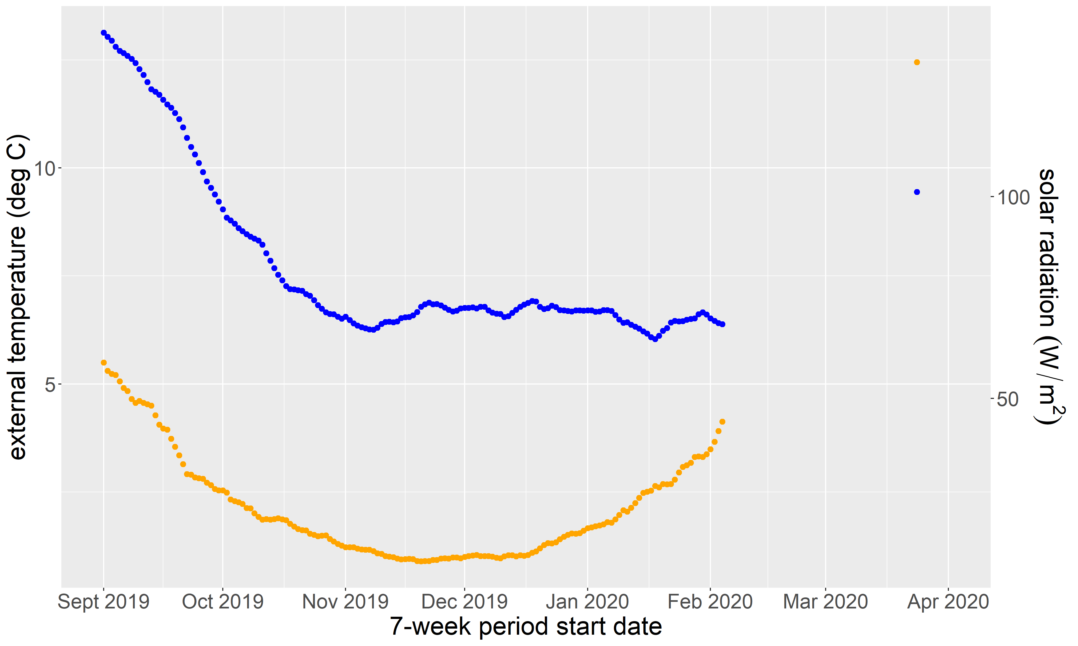
Comparing mean external temperature and solar radiation
Solar radiation during lockdown
External temperature during lockdown

Slide 13
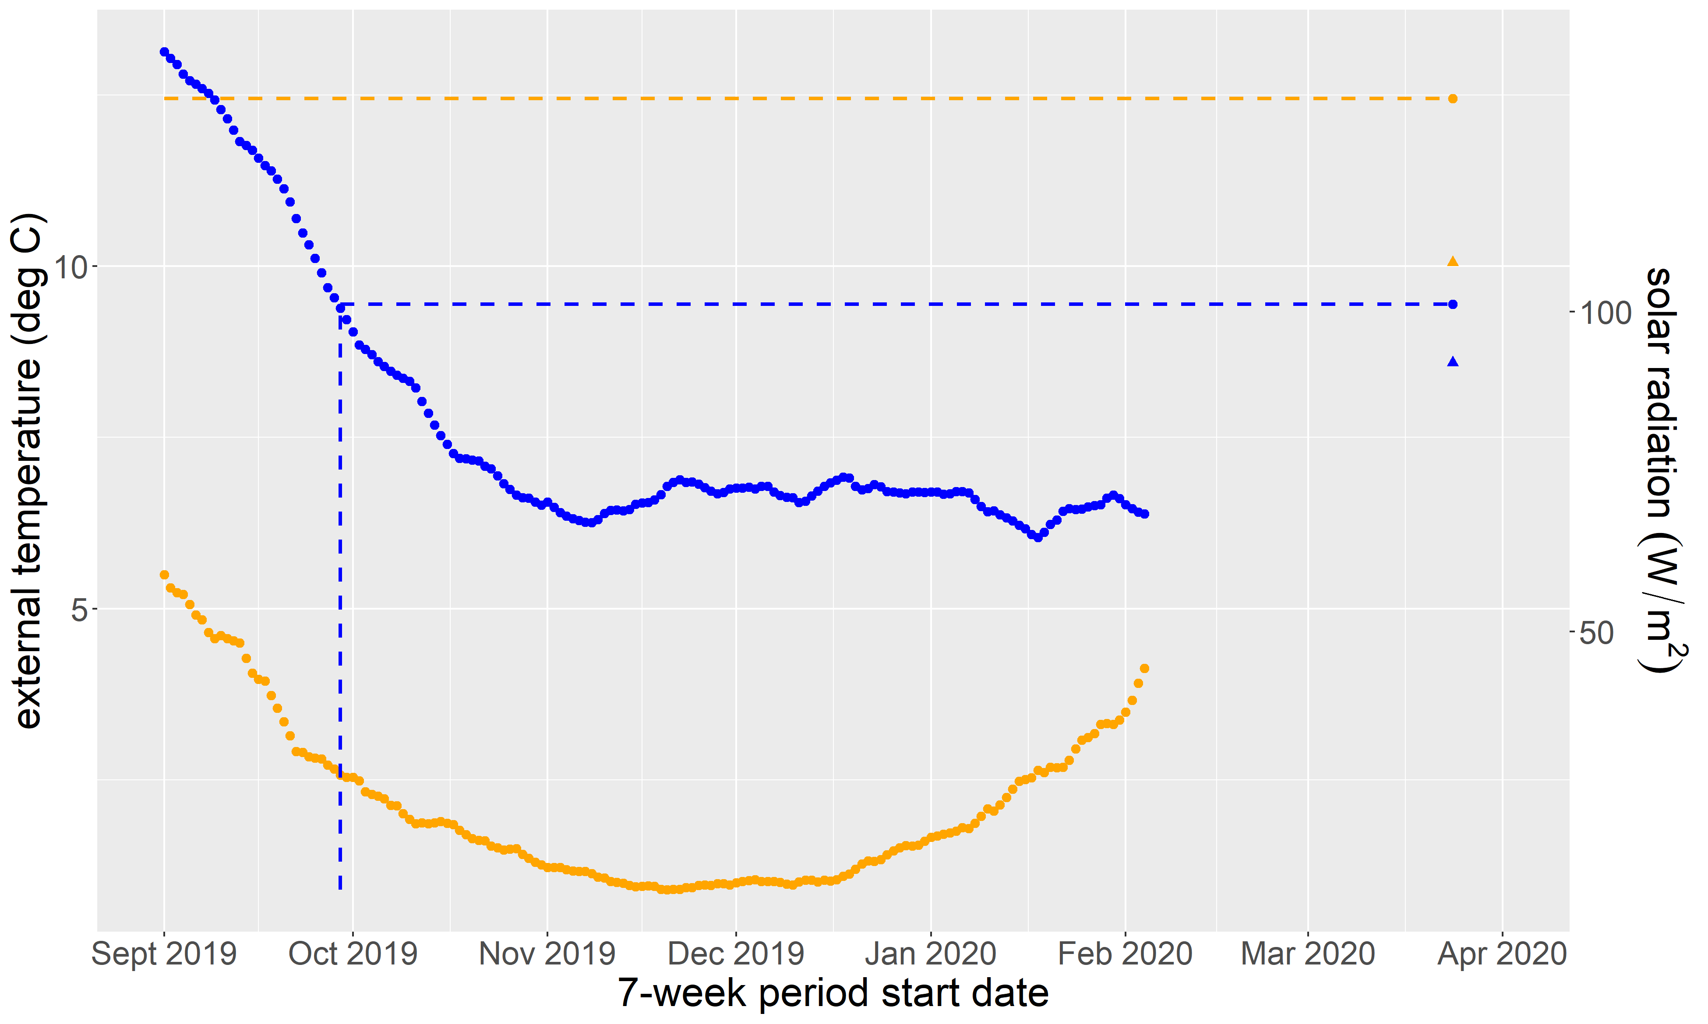
Which dates have similar conditions?

Slide 14

How about the same dates 1 year earlier?
Same date, previous year
Difference compared to same period in 2019

Slide 15




Approach: Predictive modelling
Inputs for each household
Methods
Outputs
Historic daily/half-hourly electricity and gas consumption
Historic weather (hourly)
Calendar variables
Predictive model with estimated accuracy
(one per household)
Machine learning with cross-validation, training and testing

Slide 16
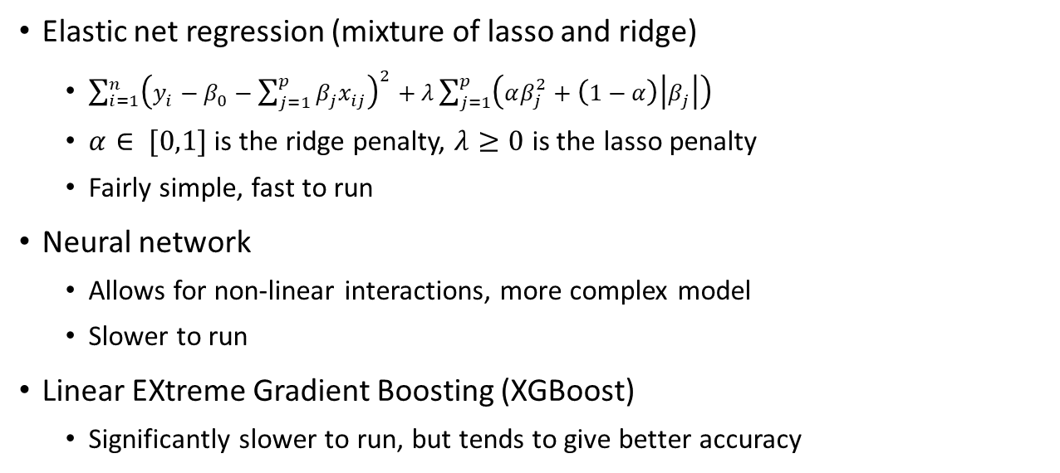
Predictive modelling techniques
Elastic net regression (mixture of lasso and ridge)
$\sum_{i=1}^{n}{{\left(y_{i}−β_{0}−\sum_{j=1}^{p}{β_{j}x_{ij}}\right)}^{2}+λ\sum_{j=1}^{p}{\left(αβ_{j}^{2}+\left(1−α\right)\left|β_{j}\right|\right)}}$
$α∈ [0,1]$ is the ridge penalty, $λ≥0$ is the lasso penalty
Fairly simple, fast to run
Neural network
Allows for non-linear interactions, more complex model
Slower to run
Linear EXtreme Gradient Boosting (XGBoost)
Significantly slower to run, but tends to give better accuracy

Slide 17
R packages of choice
data.table
caret
glmnet, nnet, xgboost
parallel and doParallel
stringr
lubridate

Slide 18
Using caret to compare models
Standard framework
easy ‘plug and play’ route to machine learning
Standard outputs – super easy to compare completely different techniques
Lots of options like pre-processing and cross-validation
Hundreds of options for machine learning models

Slide 19
Elastic net regression
library(caret) library(glmnet)
train(form = as.formula(“demand ~ temperature * weekday”), data = training_dataset, method = "glmnet", trControl = trainControl(method = "cv", number = n_folds, savePredictions = "final"), tuneLength = my_tune_length)

Slide 20
Neural network
library(caret)
library(nnet) train(formula, dt, method = "nnet", preProcess = c('center', 'scale') trControl = trainControl(method = "cv", number = n_folds, savePredictions = "final"), tuneGrid = expand.grid(size = my_size, decay = my_decay), linout = TRUE)

Slide 21
Extreme gradient boosting (XGBoost)
library(xgboost) train(formula, dt, method = "xgbLinear", preProcess = c('center', 'scale') trControl = trainControl(method = "cv", number = n_folds, savePredictions = "final"), tuneGrid = expand.grid(nrounds = n_rounds, lambda = l, alpha = a, eta = e), )

Slide 22
Elastic net regression function
Elastic_net_regression <- function(formula, dt, n_folds, tuning_length, size = NA, decay = NA, n_rounds = NA, l = NA, a = NA, e = NA) { library(caret) library(glmnet)
train(formula, dt, method = "glmnet", trControl = trainControl(method = "cv", number = n_folds, savePredictions = "final"), tuneLength = my_tune_length) }

Slide 23
Using caret to compare models
fitted <- get(model_choice)(formula = my_formula, dt = my_data, n_folds = kfolds, tuning_length = my_tune_length, preProcess = c('center', 'scale'), size = my_sizes, decay = my_decay, n_rounds = my_rounds, l = lambda, a = alpha, e = eta)

Slide 24
Using caret to compare models
fitted <- get(model_choice)(formula = my_formula,
dt = my_data,
n_folds = kfolds,
tuning_length = my_tune_length,
size = my_sizes,
decay = my_decay,
n_rounds = my_rounds,
lambda = my_lambda,
alpha = my_alpha,
eta = my_edta)
Common to all my models
Elastic net regression
Neural network
XGBoost

Slide 25
Model outputs
cv_predictions <- data.table(fitted$pred)
Merge with the training data, allows to compare cross-validated predictions with observations for each model
I eliminated models where bias was too high then took the one with lowest mean monthly error (for each household)
Get final predictions (for COVID-19 onwards (2 years)):
counterfactuals <- predict(fitted, covid_input_data)

Slide 26
Model Accuracy
XGBoost was the most accurate for most households, followed by neural network models, and a few with elastic net regression
We considered NMBE (normalised mean bias error) and CV(RMSE) (Coefficient of the Variation of the Root Mean Square Error) and consider |NMBE| < 5% and CV(RMSE) < 15% at the monthly level to be ‘good’ (ASHRAE guidance)

Slide 27
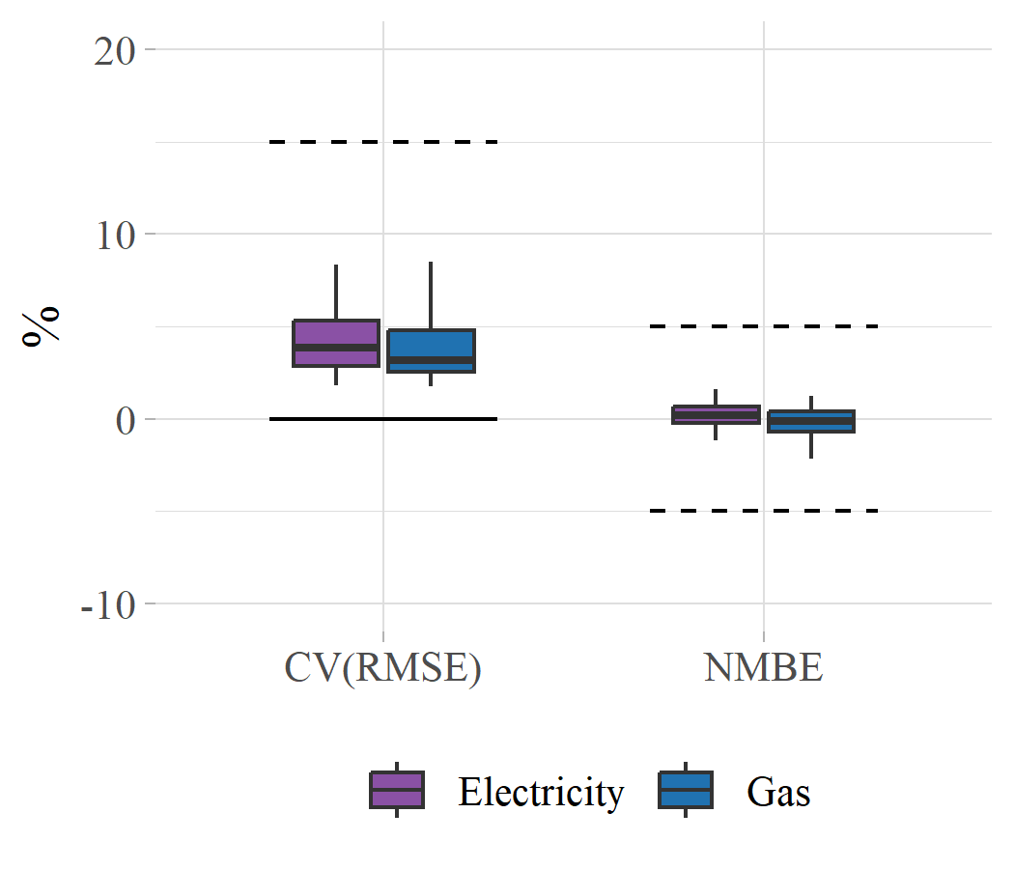
Overall error and bias

Slide 28
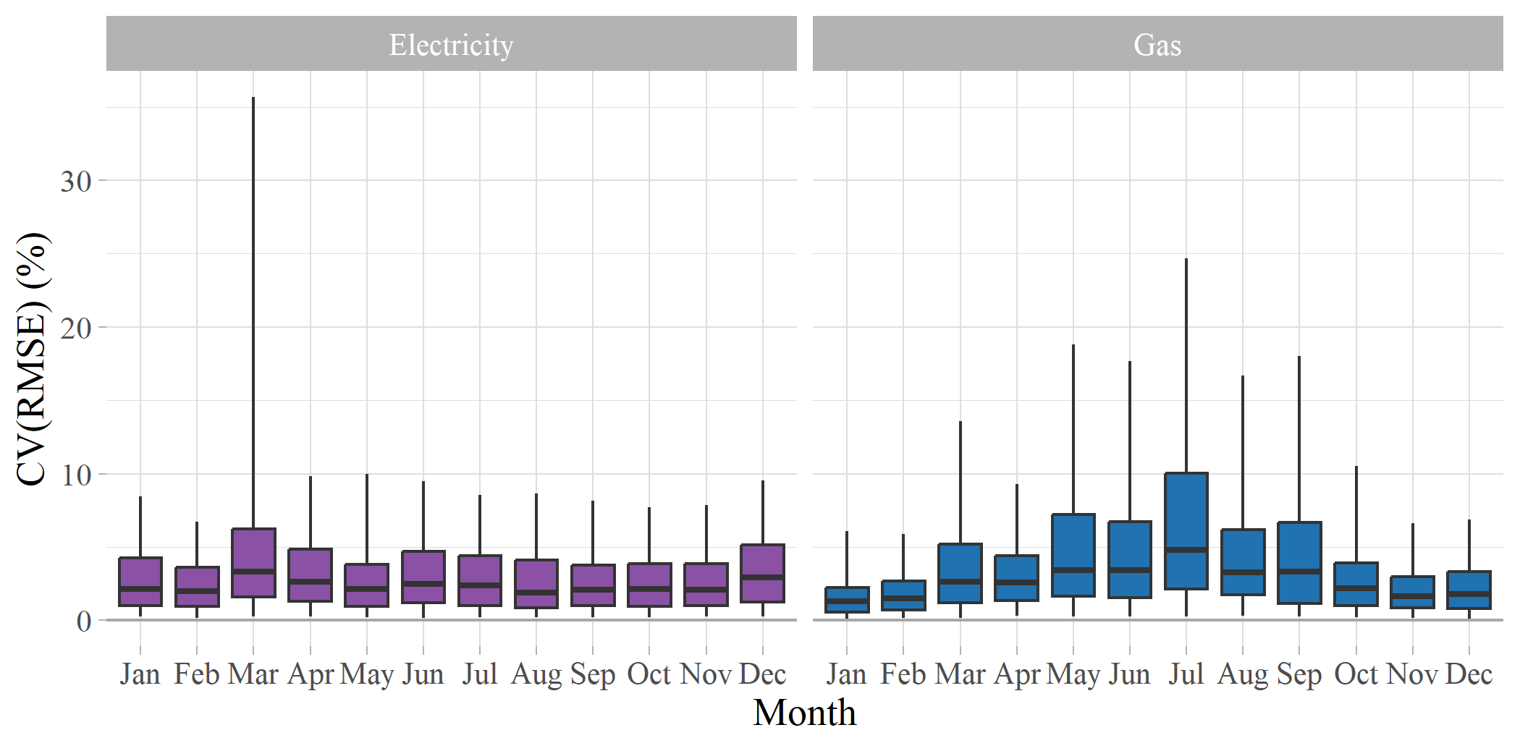
Final model accuracy: monthly error

Slide 29
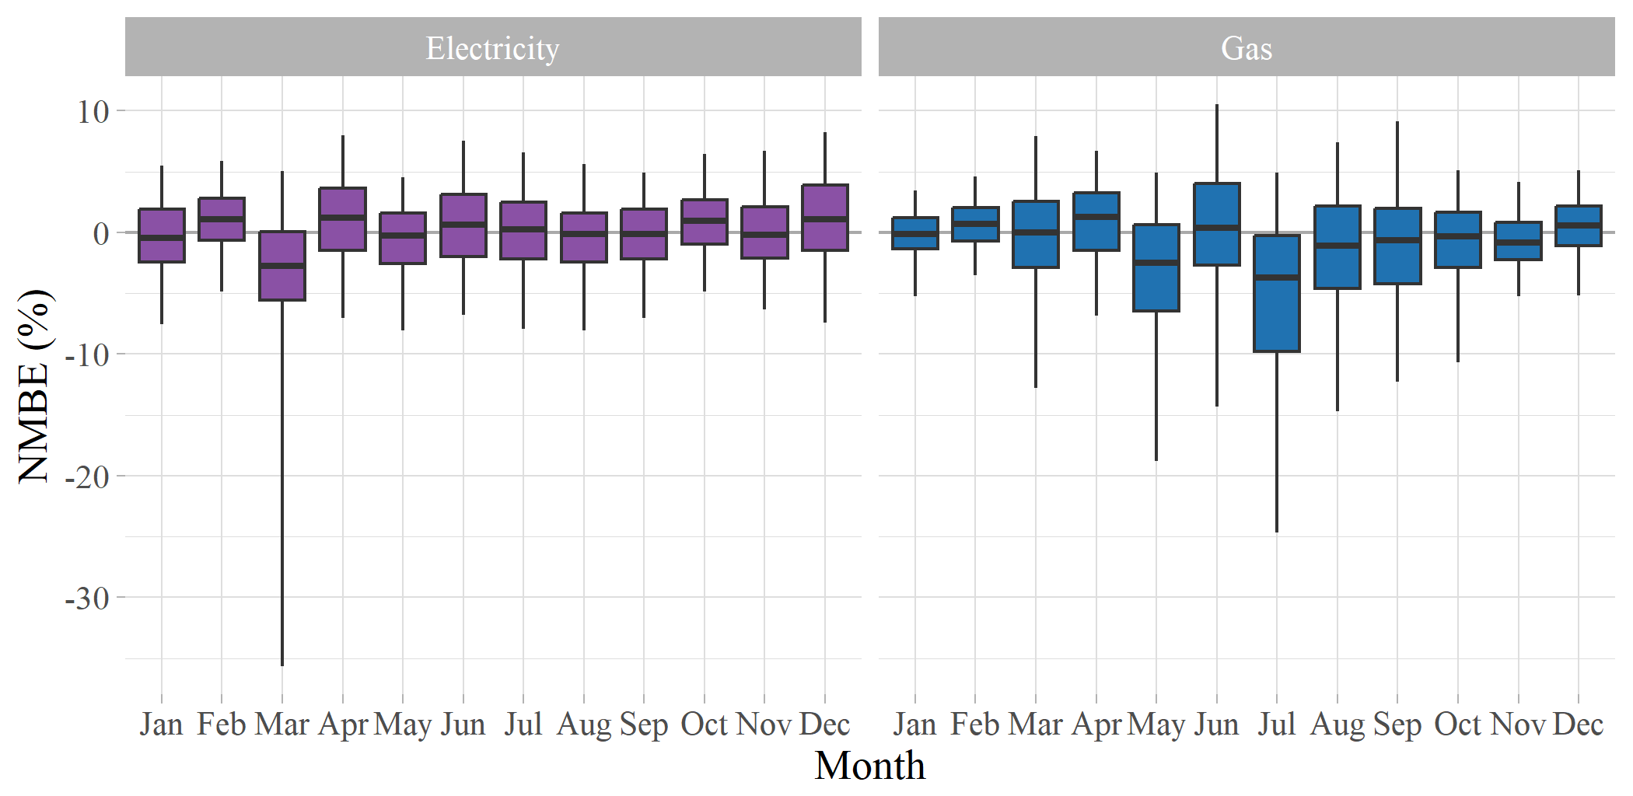
Final model accuracy: monthly bias

Slide 30
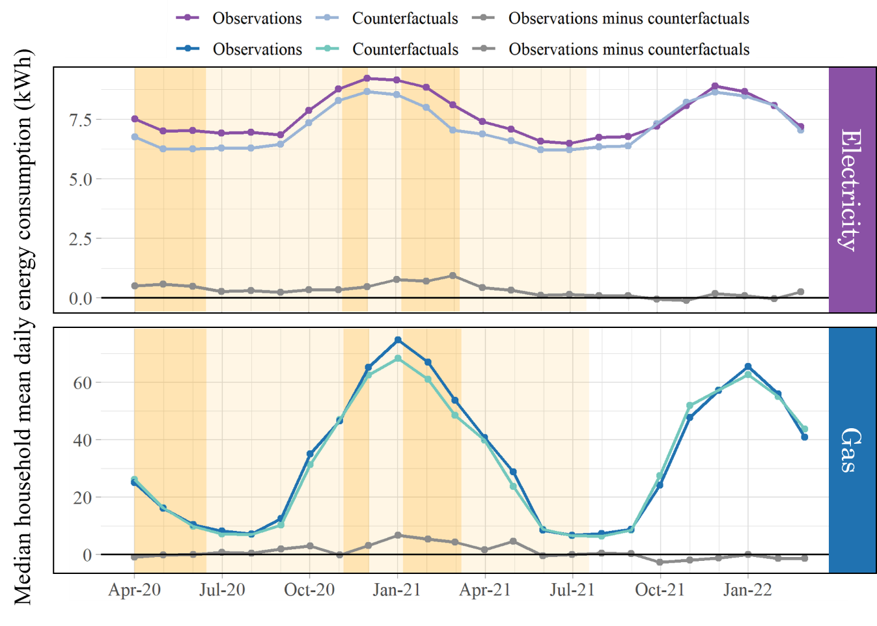
Daily consumption: actual vs predicted
Clear increase in overall consumption until autumn 2021
Increases in the 2021 winter lockdown not repeated in 2022

Slide 31
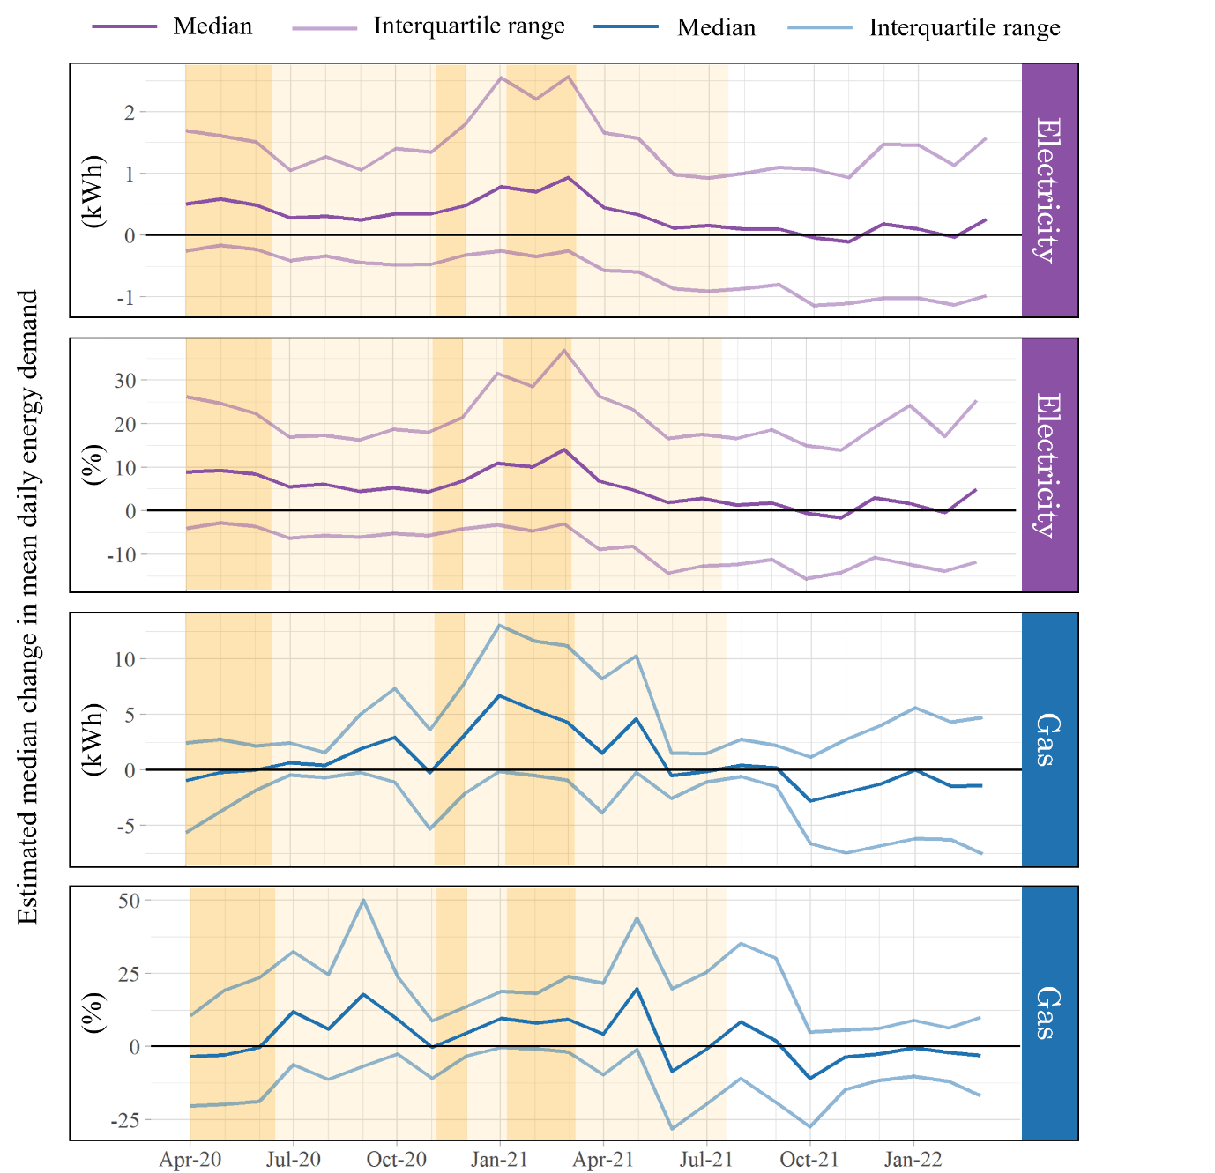
Change in consumption across the sample
Wide variety of changes
What might influence the scale and direction of change?

Slide 32
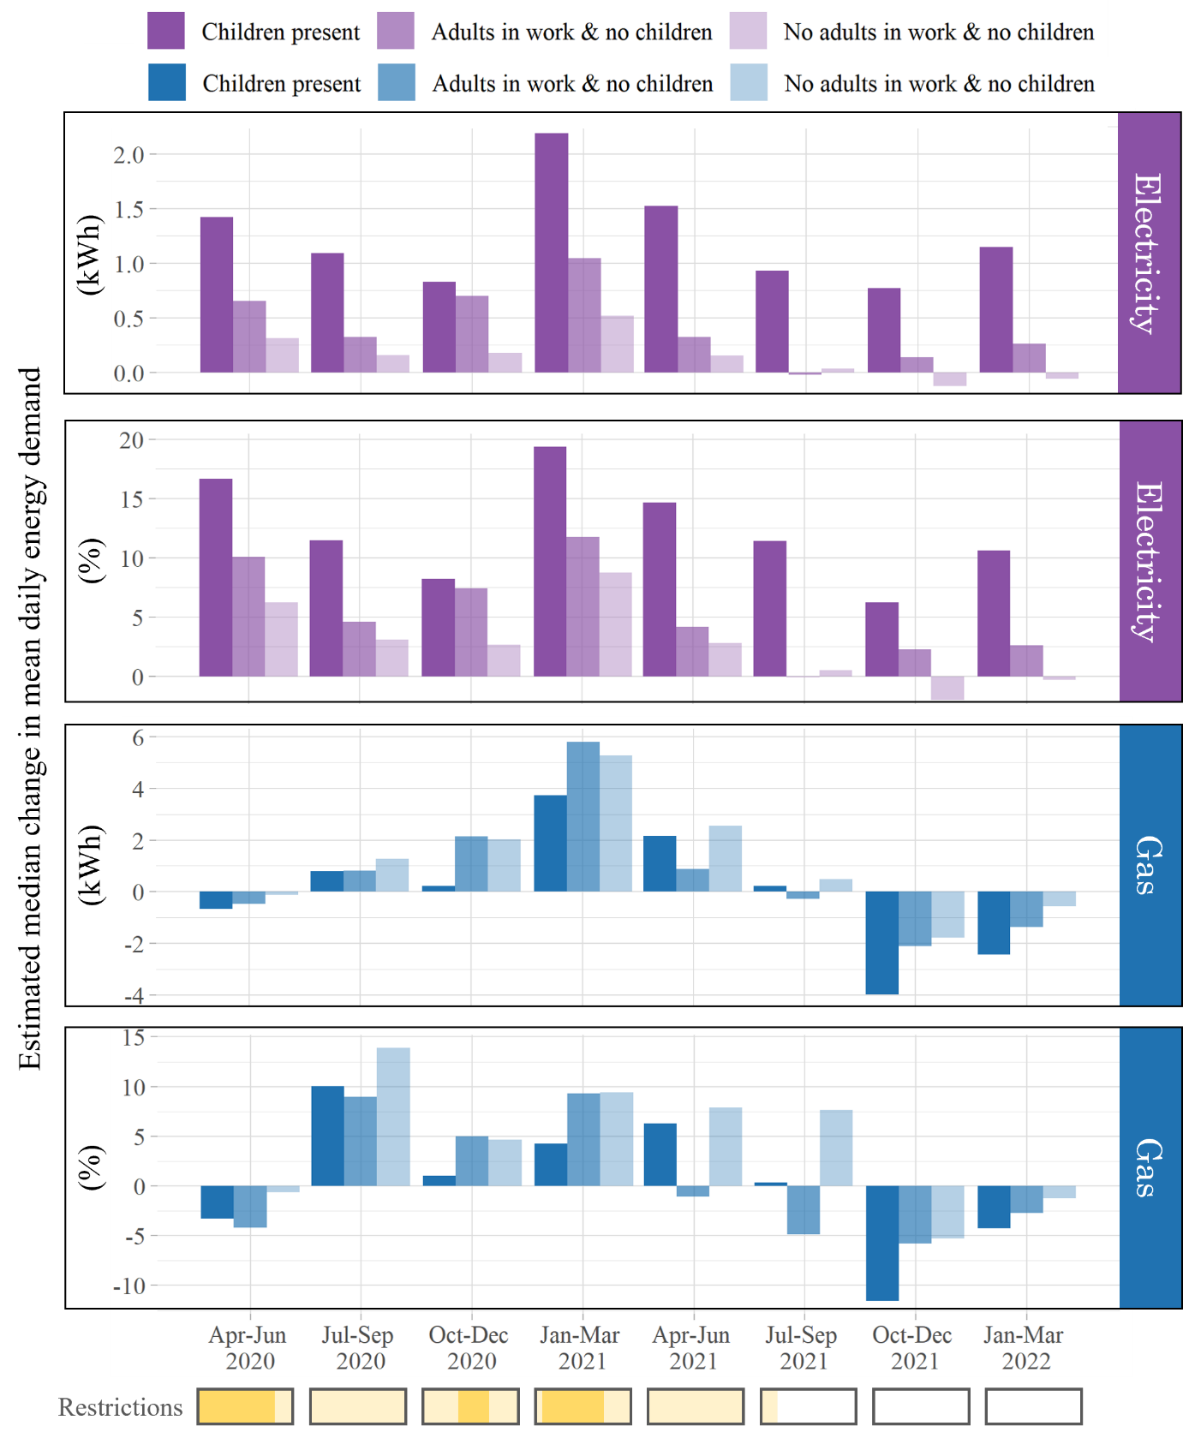
Children/people in work
Children far more influential on electricity consumption than gas
Consistently higher-than-expected consumption even 2 years on
Trends in gas data unclear
Jan-Mar 2021 (winter lockdown) biggest effect on all groups

Slide 33
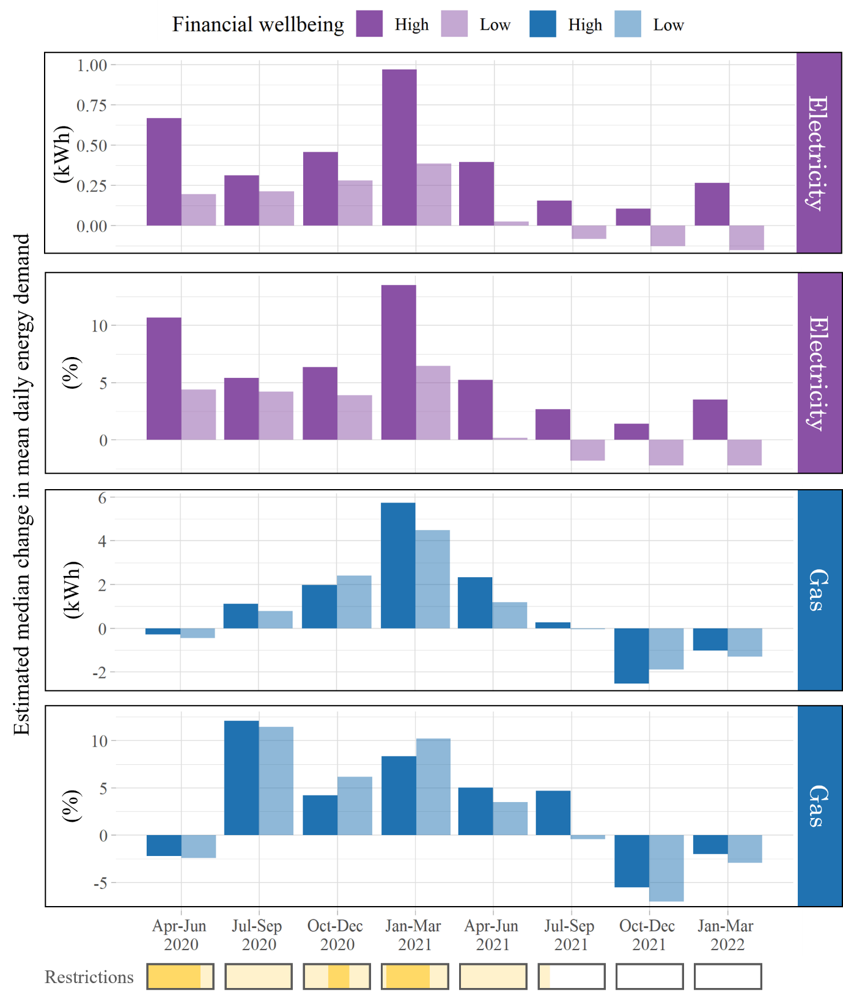
Financial wellbeing
Less well-off households increased consumption far less
More likely to be key workers? Fewer appliances? Worried about bill increases?

Slide 34
Conclusions
Big, detectable difference in consumption due to COVID-19 pandemic using predictive modelling techniques
Increases have remained for some households, but on average consumption returned to ‘normal’ at the start of 2022
Different picture for different types of household, as expected
Noticeable differences by financial wellbeing and presence of children and working adults

Slide 35
What’s next?
Submitting our paper at the end of next week “The short- and long-term impacts of COVID-19 on household energy consumption in England and Wales”
Explore how the cost-of-living crisis has affected energy consumption
Data for ~12,000 households from the last 2 years
Same techniques apply – challenge is to determine the most appropriate training period (energy bill rises overlap with COVID-19 variant rises)

Slide 36
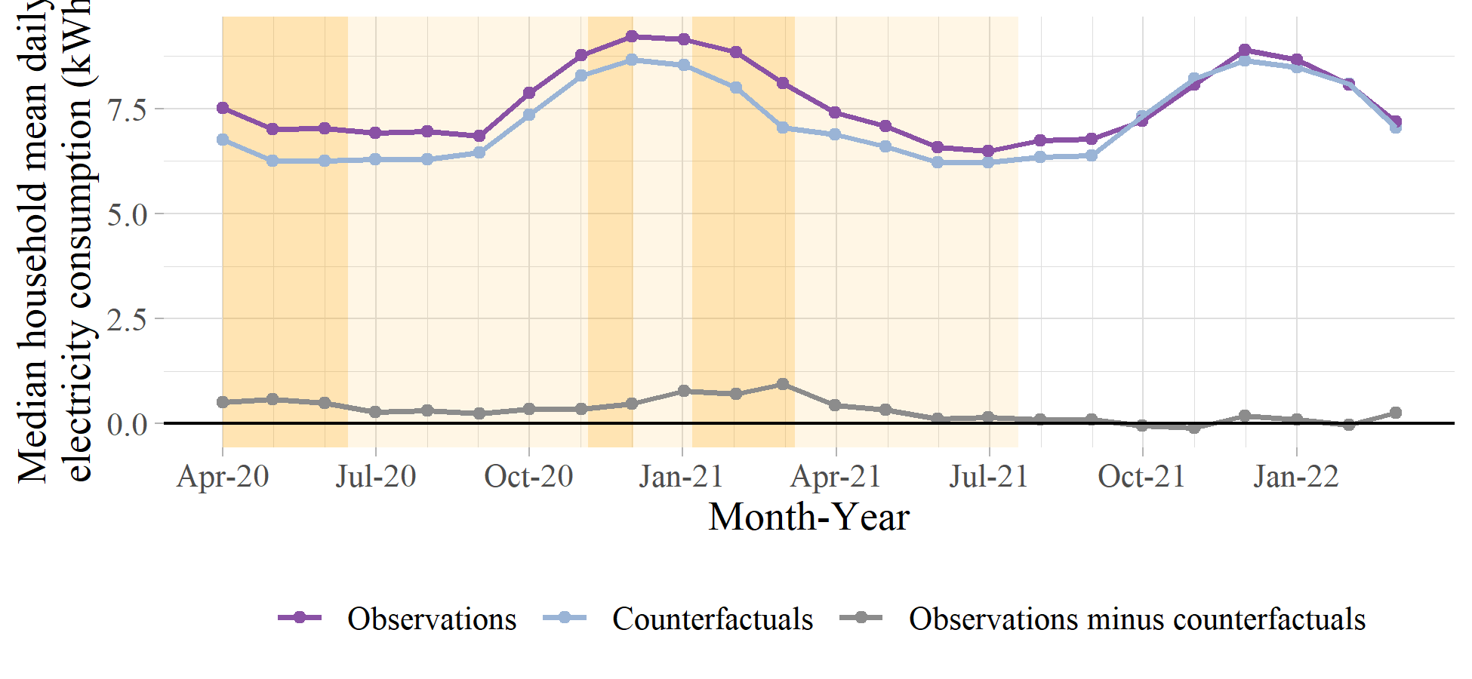
Creating figures in Rmarkdown (+powerPoint)

Slide 37
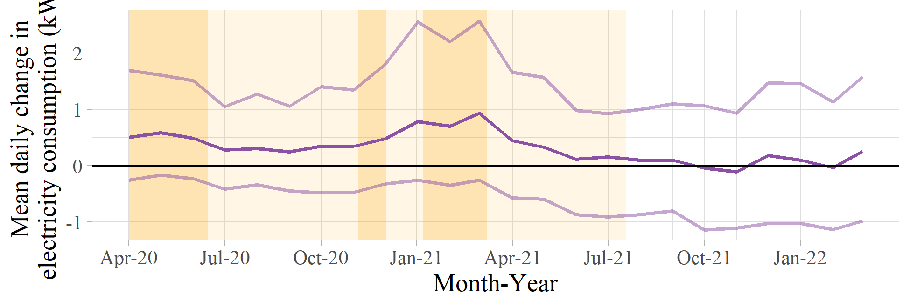

Slide 38
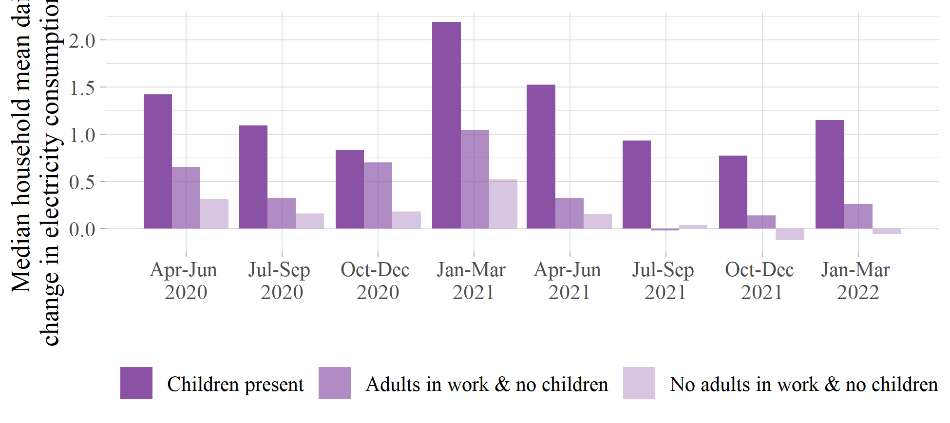

Slide 39


Why not join the
UCL R User Group
Next talk:
Visualizing choice experiment data in ggplot
Thursday 16th March 1pm
e.webborn@ucl.ac.uk
Dr Ellen Zapata-Webborn, UCL Energy Institute
www.ellenwebborn.com/rusergroup

Slide 40
Any questions?
Paper pre-print: https://osf.io/m5p3b/
Dr Ellen Zapata-Webborn
www.ellenwebborn.com
@ellenwebborn
e.webborn@ucl.ac.uk
Research funded by EPSRC and NGED (formerly WPD)
SERL publications
https://serl.ac.uk/key-documents/
For any questions regarding SERL or access to SERL data please contact
James O’Toole
SERL Consortium Manager
j.otoole@ucl.ac.uk
www.serl.ac.uk

